Slide 1

Combining Blockchain and Machine Learning to Forecast Cryptocurrency Prices
Kevin Martin, Izzat Alsmadi, Mohamed Rahouti, Moussa Ayyash
The Second International Conference on Blockchain Computing and Applications
November 2 – November 5, 2020

Slide 2
Research Goals
Which features of cryptocurrency trading will best predict future price movements?
Can a model based solely on features accurately predict Bitcoin prices?
Can we develop an accurate pricing algorithm, and if so, which method would yield the best results?

Slide 3
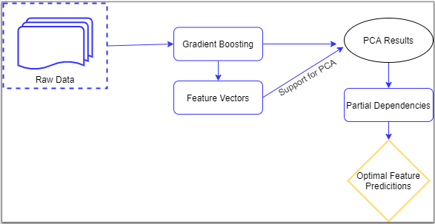
Feature Selection
Features selected using gradient boosting and supported with PCA
Potentially usable features: volume, market cap, capitalization change 1 day and max supply

Slide 4
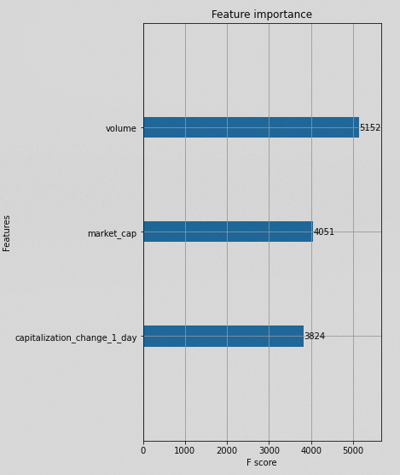
Feature Selection - Continued
Apply XGBoost to expedite hyper parameter tuning, further expedited by Dmatrix function
Top three features chosen based on F1 Scores, which consider both precision and recall

Slide 5
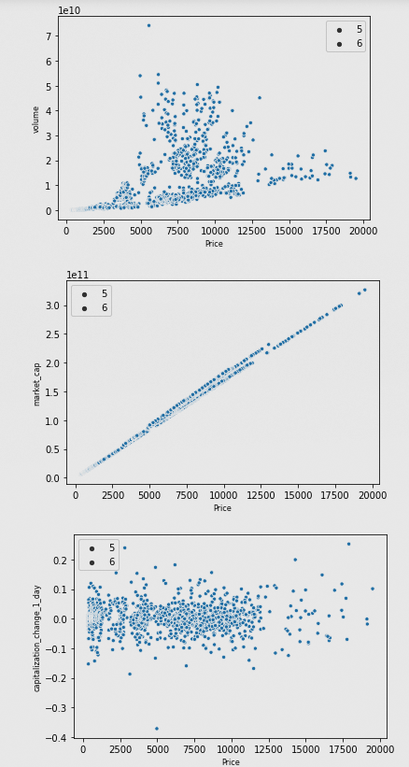
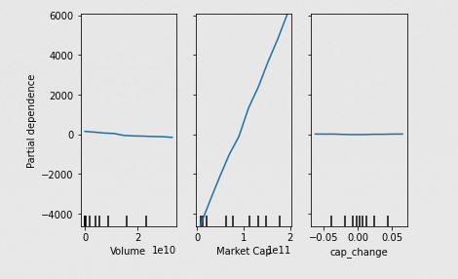
Feature Selection - Continued
Scatterplot vs. partial dependencies
Market Cap (total dollar value of outstanding coins) is clearly the strongest

Slide 6
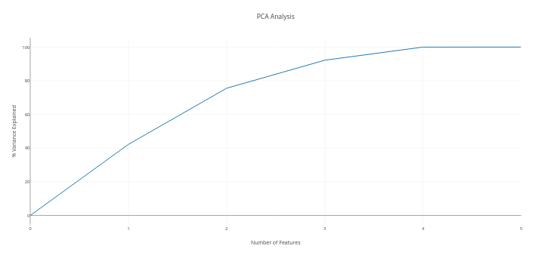
Feature Selection - Continued
Results of PCA showing how three features can explain over 90% of the variance

Slide 7
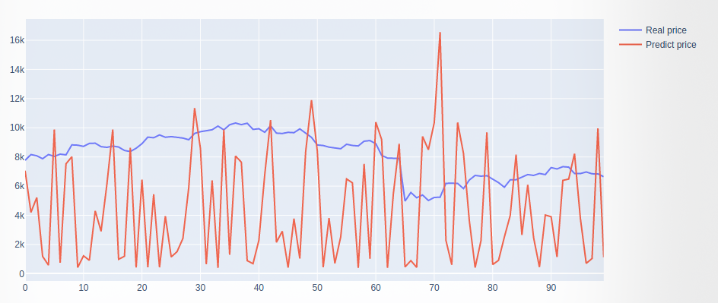
Feature Selection - Continued
Price prediction based solely on feature selection generates poor results
Given the nature of the task, feature-only price prediction is an inappropriate methodology

Slide 8
Time Series Analysis - Introduction
Sequential Neural Network to predict price with 70/30 train/test split
Using the mean squared error (MSE) and mean absolute percent error (MAPE) as accuracy measures
Compare to both average and moving average

Slide 9
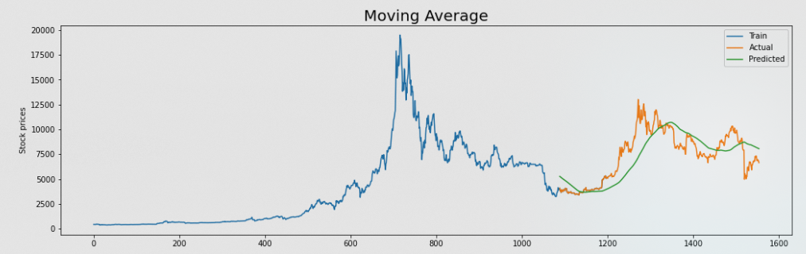
Time Series Analysis – Moving Average
Moving average closer than initially anticipated
Helped validate train/test split

Slide 10
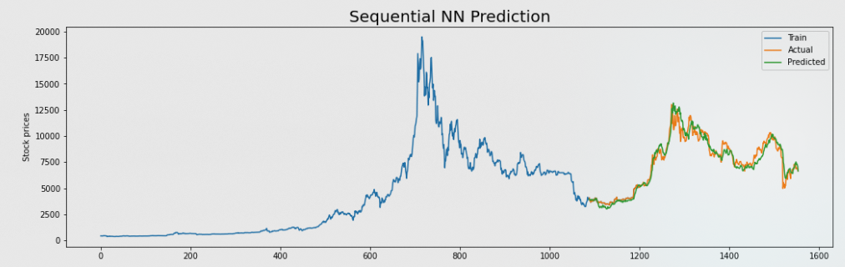
Time Series Analysis - SNN
Most sophisticated single-algorithm
Not (relatively) computationally intensive, allowed for more tuning and experimentation
Over five times better than moving average (via MSE)

Slide 11
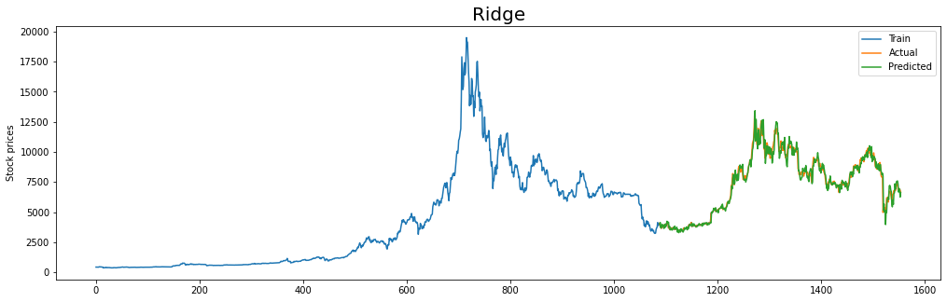
Linear Regression Approaches
Best single-algorithm performance
Helped with highly volatile price swings by standardizing data

Slide 12
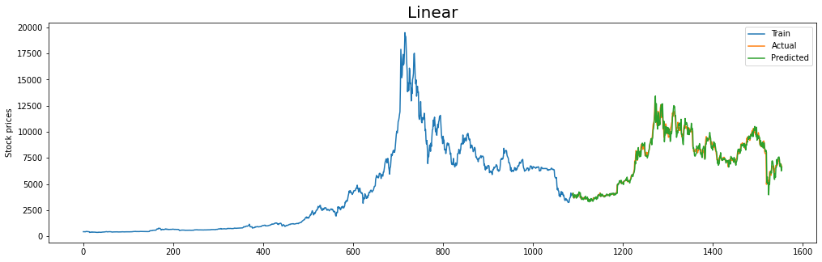
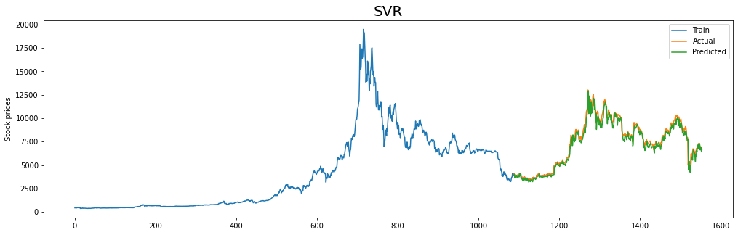
Linear Regression Approaches
Both outpeformed SNN by similar margins

Slide 13
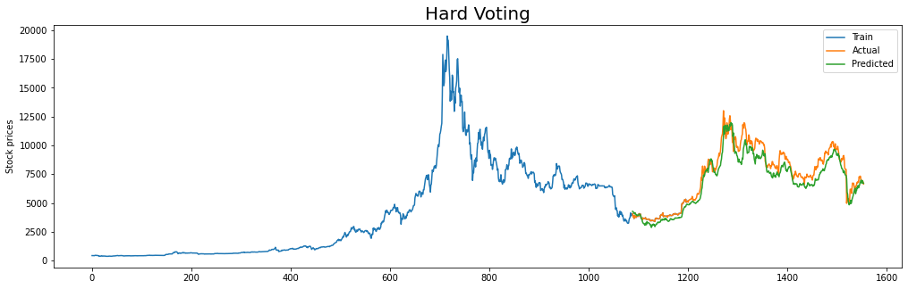
Ensemble Method – Hard Voting
Poor performance relative to each of the individual models
“Polling” method too extreme to produce improved results

Slide 14
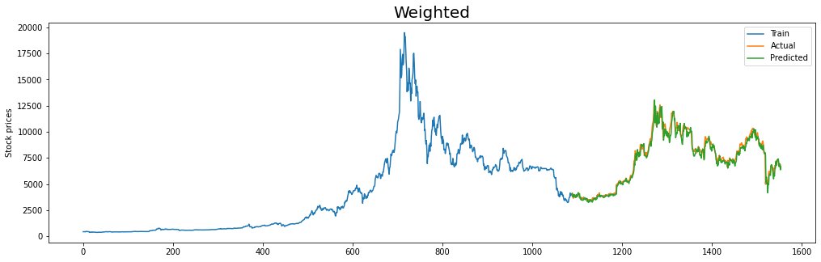
Ensemble Method – Weighted
Best performance observed, in both in terms of MAPE and MSE
Weighted approach helped temper results, allowing for best price prediction

Slide 15
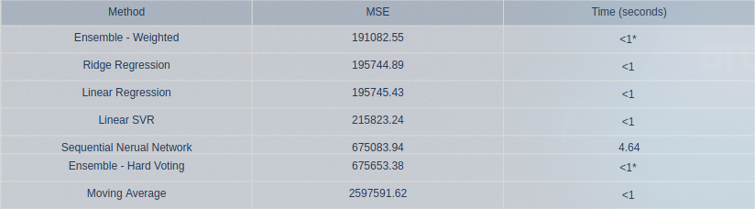
Method Summary
Examining the results of approaches taken
Note the extremely quick time to train in all cases

Slide 16
Conclusions
Leverage blockchain infrastructure to derive statistically useful features for price prediction
Develop multiple machine learning models based on these features with varying degrees of success
Synthesize multiple models for more sophisticated ensemble approach

